Slide 1

PREDICTION OF THE STORAGE MODULUS CURVE OF A THERMOSET BASED SHAPE MEMORY POLYMER USING MACHINE LEARNING
PRESENTED BY: AMA A. DARKWAH
SUPERVISED BY: DR CHENG YAN

Slide 2
OUTLINE OF PRESENTATION
Introduction
Problem Statement
Relevant Literature
Objective
Work Done
Current Work
Next Step

Slide 3
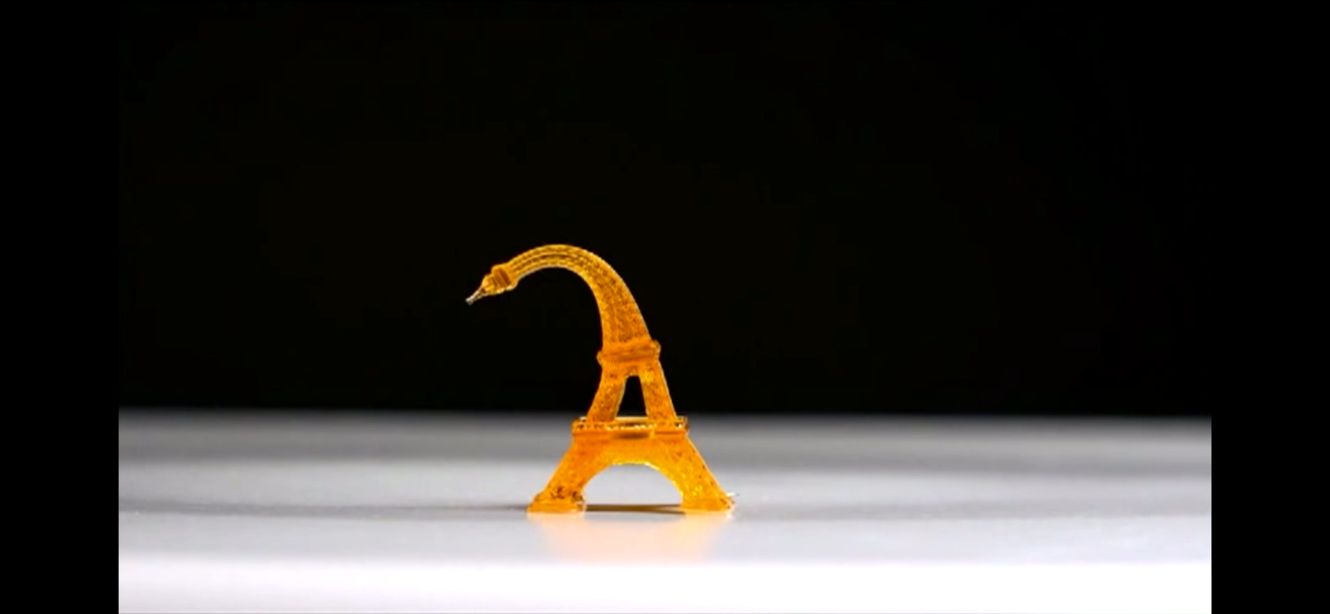
INTRODUCTION
Shape memory polymer (SMP) is a type of smart material, which can return to the initial shape by responding to external stimuli such as
heat
moisture
magnetism
ph solution etc.

Slide 4
Shape memory polymers are used in areas such as
Aviation
Health
Fashion
Automobile engineering

Slide 5
INTRODUCTION CONT’D
Machine learning is when we teach computers to learn patterns in data such that they can recognize those patterns and apply them to new things.
A neural network is a machine learning algorithm that mimics the human brain to recognize relationships in data
Notes:
Neural networks “learn” to perform tasks by considering examples, generally without being programmed with any task-specific rules.

Slide 6
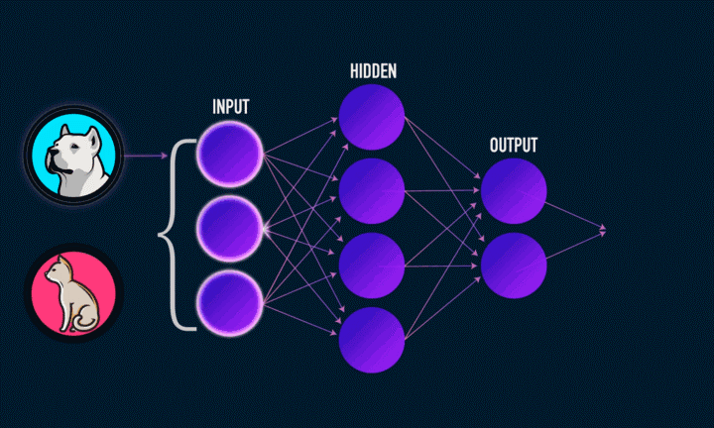
INTRODUCTION CONT’D
Notes:
Input layer — initial data for the neural network.
Hidden layers — intermediate layer between input and output layer and place where all the computation is done.
Output layer — produce the result for given inputs.

Slide 7
PROBLEM STATEMENT
In the synthesis of SMPs;
Experiments and molecular dynamics (MD) simulations are fairly time-consuming
Improving target behavior is limited to the researcher’s cognition

Slide 8
THE SOLUTION
Compared with the molecular dynamics models, machine learning has a speed advantage
Given enough data, Machine learning methods can effectively extract useful information, eliminating cognition
ML has a potential to produce a universal model instead of a specific model.
Notes:
Molecular dynamics (MD) is a computer simulation method for analyzing the physical movements of atoms and molecules

Slide 9
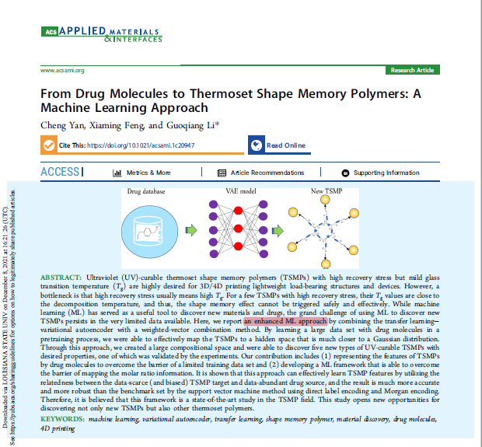
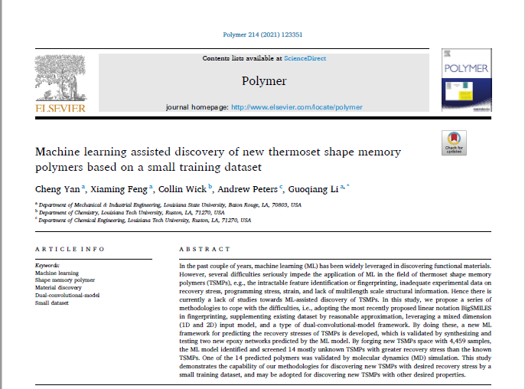
RELEVANT LITERATURE
Yan et al. (2020)
Yan et al. (2021)

Slide 10
OBJECTIVE
Predict storage modulus curve of a thermoset shape memory.
Notes:
Storage modulus is the indication of the ability to store energy elastically.

Slide 11
WORK DONE
Studied and understood the architecture of neural networks
Studied and understood the math behind neural networks
Taylor series for parameter approximation
Differentiation for back propagation etc.
Run a classification code from scratch

Slide 12
CURRENT WORK
Building a neural network (regression model) from scratch
Reviewing relevant literature
Studying polymer chemistry

Slide 13
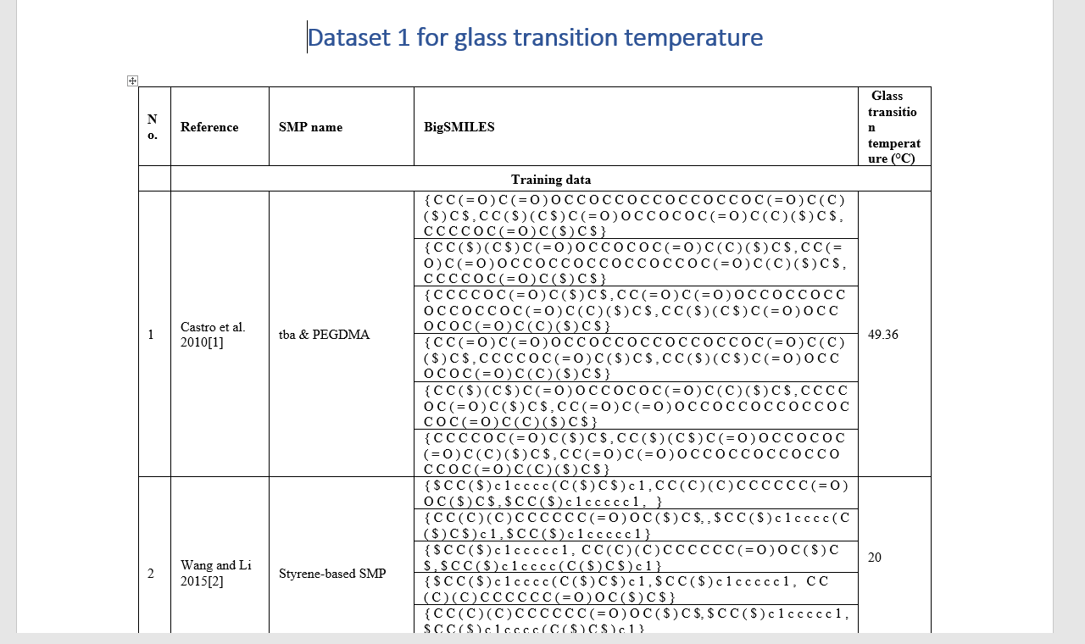
NEXT STEPS
Build a database for the model by reviewing relevant literature.
Study and understand fingerprinting in neural networks using TensorFlow

Slide 14

THANK YOU

